Slide 1

Lecture 3.4 – CUDA Parallelism Model
GPU Teaching Kit
Image Blur Example

Slide 2
Objective
To learn a 2D kernel with more complex computation and memory access patterns

Slide 3
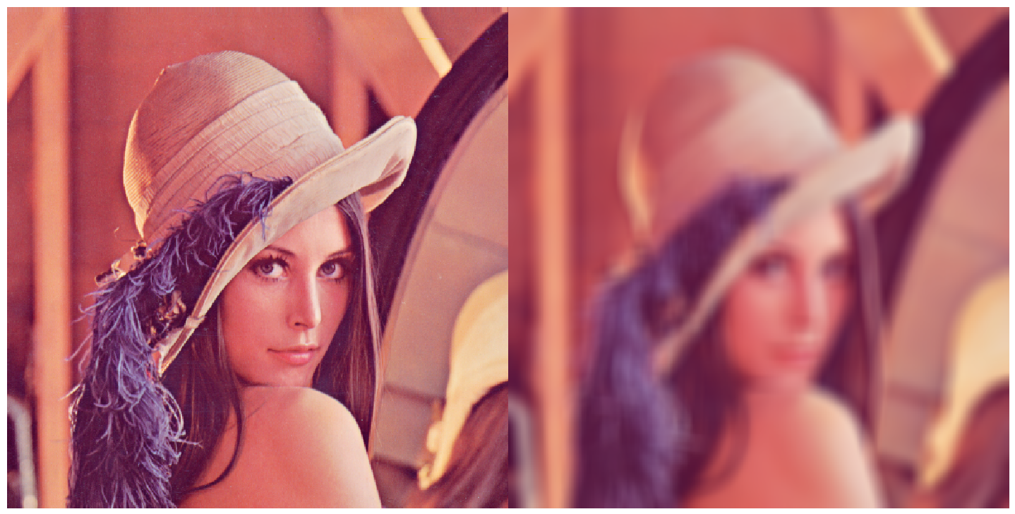
Image Blurring

Slide 5
Image Blur as a 2D Kernel
__global__
void blurKernel(unsigned char * in, unsigned char * out, int w, int h)
{
int Col = blockIdx.x * blockDim.x + threadIdx.x;
int Row = blockIdx.y * blockDim.y + threadIdx.y;
if (Col < w && Row < h) {
... // Rest of our kernel
}
}

Slide 6
__global__
void blurKernel(unsigned char * in, unsigned char * out, int w, int h) {
int Col = blockIdx.x * blockDim.x + threadIdx.x;
int Row = blockIdx.y * blockDim.y + threadIdx.y;
if (Col < w && Row < h) {
int pixVal = 0;
int pixels = 0;
// Get the average of the surrounding 2xBLUR_SIZE x 2xBLUR_SIZE box
for(int blurRow = -BLUR_SIZE; blurRow < BLUR_SIZE+1; ++blurRow) {
for(int blurCol = -BLUR_SIZE; blurCol < BLUR_SIZE+1; ++blurCol) {
int curRow = Row + blurRow;
int curCol = Col + blurCol;
// Verify we have a valid image pixel
if(curRow > -1 && curRow < h && curCol > -1 && curCol < w) {
pixVal += in[curRow * w + curCol];
pixels++; // Keep track of number of pixels in the accumulated total
}
}
}
// Write our new pixel value out
out[Row * w + Col] = (unsigned char)(pixVal / pixels);
}
}

Slide 7
The GPU Teaching Kit is licensed by NVIDIA and the University of Illinois under the Creative Commons Attribution-NonCommercial 4.0 International License.

